Slide 1

CyberProtect Inc. Breach Investigation and Report
Date: May 13, 2025
By: Sergey Dmitriev, Max Stringer, Bohdan Torubara

Slide 2
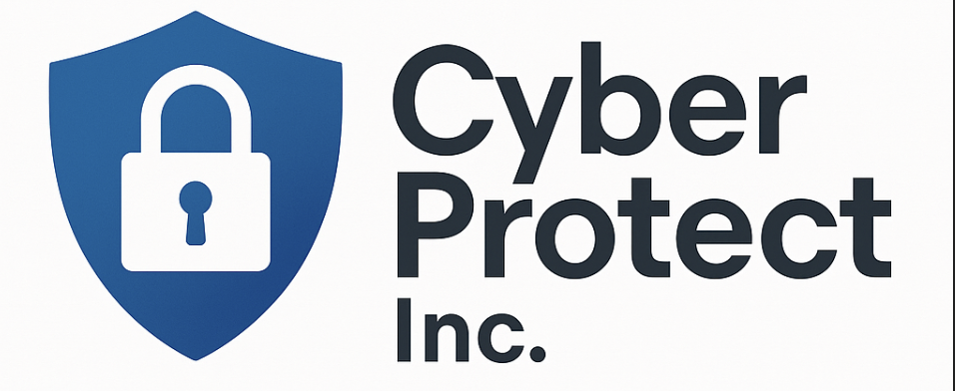
This case study looks at a cybersecurity breach at CyberProtect Inc., a company that protects private data for clients and employees.
The attack began when staff members received a fake email that tricked them into giving away their login information. Using this, hackers broke into the company’s systems, stole sensitive data, and tried to use it to extort the company.
In this report, we will explain how the attack happened, what security weaknesses were missed, and what CyberProtect Inc. can do to fix the damage and stop attacks in the future. We will show evidence like system logs, emails, and IP addresses to show each step of the breach and give our recommendations for both technical and non-technical improvements.

Slide 3
What happened
Hackers sent a fake email to employees pretending there was a security issue. When employees clicked the link and entered their info, the hackers stole their usernames and passwords.
They used Jane Smith’s login from a foreign location and later used John Doe’s account to steal 500MB of private company data. They then sent a threat to the admin, asking for something in return or they’d leak the data.
The attack was planned to look like normal activity between employees, but logs and emails revealed the truth.
sergey

Slide 4
How it happened
Phishing email tricked employees into clicking a fake link that lookedlike it was from IT Support.
Passwords were stolen when employees typed them into a fake loginpage.
Hacker used Jane Smith’s account to log in from a strange locationthat didn’t match her history.
John Doe’s account was used to secretly send out 500MB of privatedata from the company.
System logs showed every step, including logins, file transfers, andwhere the data went.
sergey

Slide 5
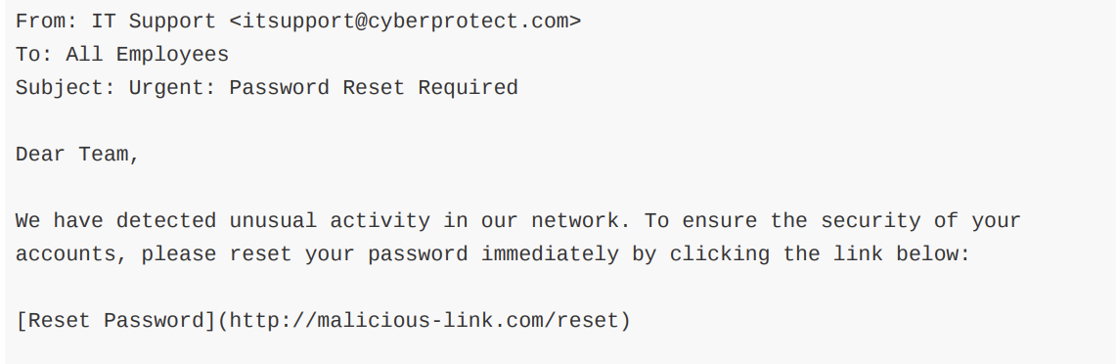
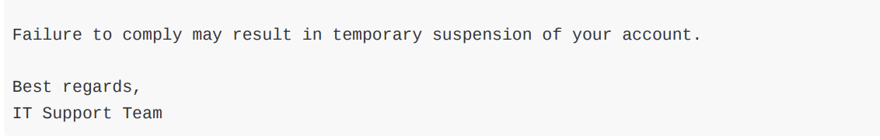
How it happened (Emails)
Email 1: Said there was suspicious activity and asked for a password reset. The link went to a fake website that stole employee login info.
sergey

Slide 6
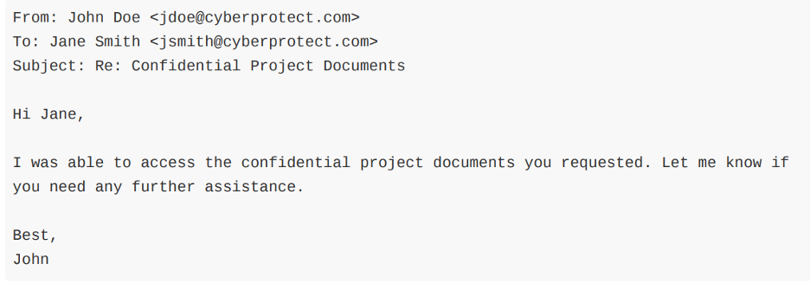
How it happened (Emails)
Email 2: Looked like a normal message between John and Jane, but was really used to hide a big data transfer from security checks.
sergey

Slide 7
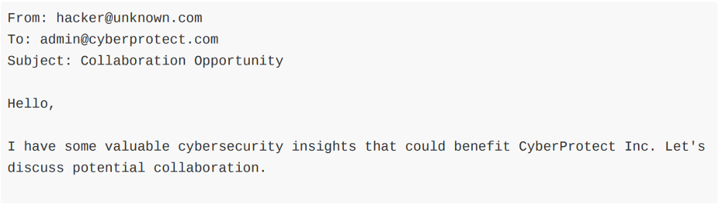
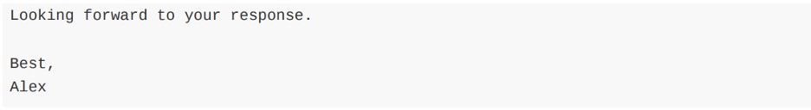
How it happened (Emails)
Email 3: Sent by the hacker after the data was stolen, demanding money or else the stolen files would be made public.
sergey

Slide 8
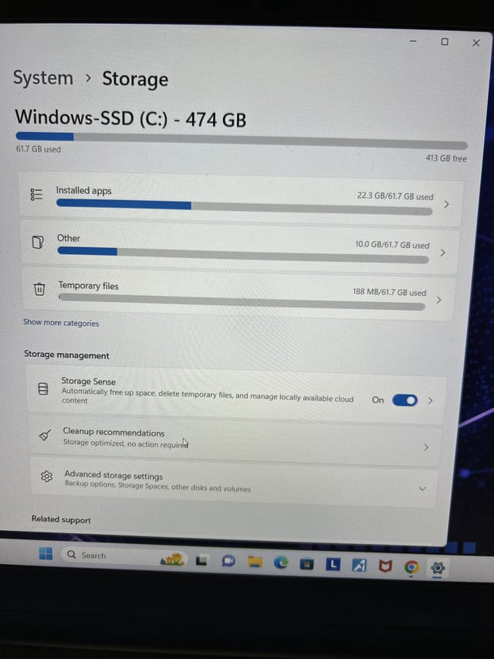
What was stolen (detailed)
HR Records: Private employee files used by Human Resources
Social Security Numbers: Personal ID numbers used for taxes and jobs
PII (Personally Identifiable Information): Names, addresses, phone numbers, etc.
Internal Company Documents: Work files and memos not meant to be public
Project Files: Documents about future company projects and ideas
Strategic Plan (2024–2026): Company’s secret goals using encryption and AI
Total Data Stolen: About 500 MB of sensitive company information
sergey

Slide 9
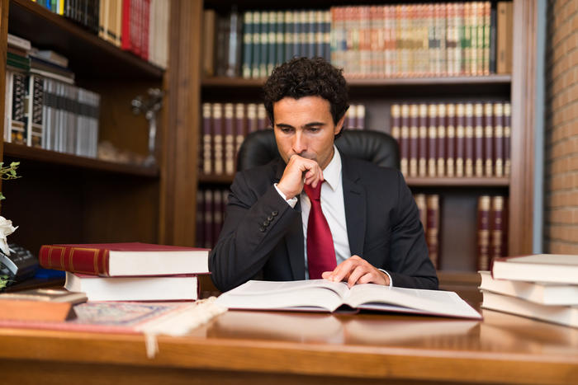
What it cost (Financial Costs)
Cybersecurity Experts: Hired to investigate how the hack happened
Legal Fees: Lawyers needed to handle possible lawsuits or penalties
System Upgrades: Security software and hardware had to be improved
Fines: Possible payments for breaking data privacy laws
sergey

Slide 10
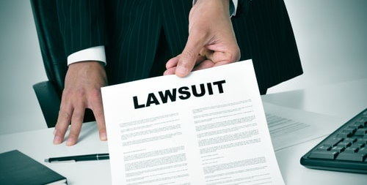
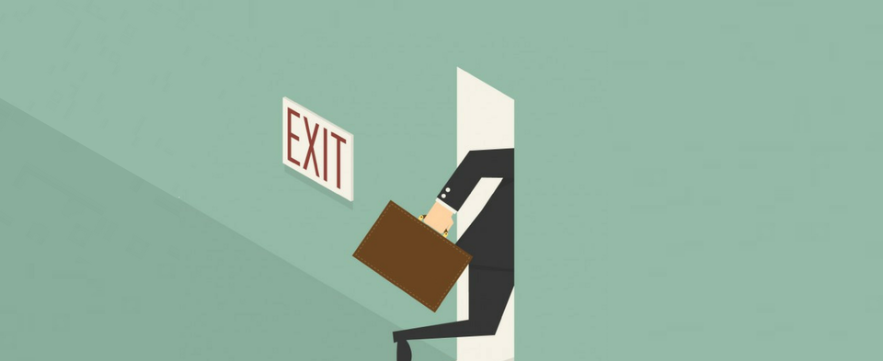
What was lost
Reputation Damage: Customers and employees might stop trusting the company
Legal Trouble: Company may be sued for not protecting private data
Loss of Business: People might not want to work with or buy from the company anymore
customer
sergey

Slide 11
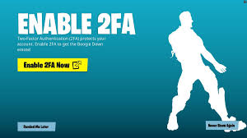
Fixing the Problems Stopping Hackers with Multi-Factor Authentication
CyberProtect got hacked because employees’ passwords were stolen.
Multi-Factor Authentication (MFA) adds a second step after the password, like a code sent to your phone.
Even if a hacker gets your password, they still can’t log in without that code.
Jane Smith’s account was used from a weird location — MFA would have stopped it.
It’s a simple way to make accounts way more secure.
bohdan

Slide 12
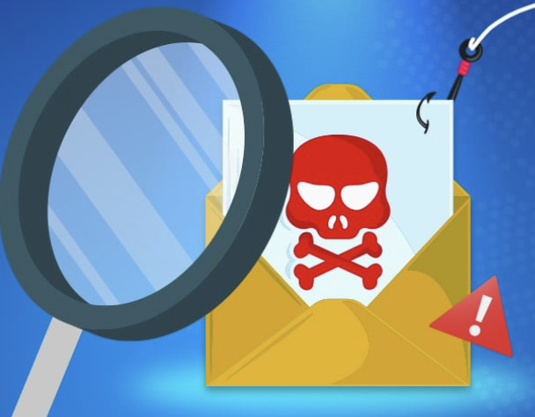
Fixing Problems Training Employees to Spot Phishing Attacks
The hackers tricked employees with a fake email that looked real.
Some workers clicked the link and gave away their login info.
With better training, they would have known the email was fake.
CyberProtect should teach employees how to spot warning signs like:
Weird links
Spelling mistakes
Messages that feel urgent or pushy
If staff were trained, this whole breach might not have happened.
bohdan

Slide 13
Technical Info
Files that are encrypted become secret codes that can only be read with a key.
Without the key, hackers can't use or understand the data.
Big companies like Apple use something called AES-256 encryption, which is one of the strongest out there.
If CyberProtect used AES-256, the stolen data would be useless to the hacker.
It scrambles the data, so even if someone gets it, they can't read it.
max

Slide 14
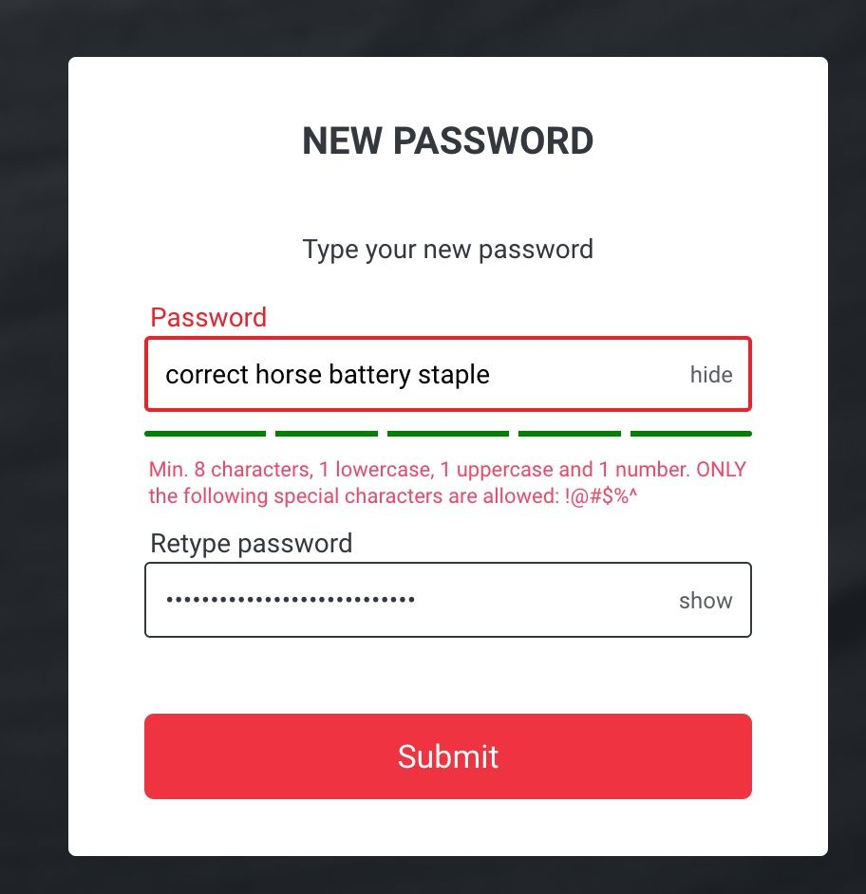
Password policy
A good password policy keeps accounts safe from hackers.
The company should set rules like:
Must have at least 1 capital letter
Must be at least 10 characters long
Must have at least 1 lowercase letter
Must have at least 1 special character (!, @, $)
Must have at least 1 number
These rules make it way harder for someone to break into an account.
max

Slide 15

The 3 main Ethical questions
Should the Company Tell the Public?
What’s the Conflict?
Who’s Affected?
max

Slide 16

Should the Company Tell the Public?
Yes, the business should tell the public about data breaches.
Being honest shows they care about doing the right thing.
In many places, it’s also required by law to report breaches.
People might be upset at first, but they will see the company is trying to fix the issue.
If the company hides it, their reputation could be ruined later.
In the long run, telling the truth is the better option.
max

Slide 17
What’s the Conflict?
The company and the public want different things.
Customers want privacy and honesty.
The company might want to hide the breach to protect their image.
But being honest protects everyone and builds trust.
It also helps the company get a better reputation for disclosing the breach.
max

Slide 18
Who’s Affected?
Two main groups are hurt by the breach: customers and employees.
Employees worry about their private info and work being stolen.
Customers might lose trust in the company and feel unsafe.
This can lead to people leaving the company or speaking out.
max

Slide 19
Conclusion
What we Learned
How we learned to Stay Safe
What Working together taught us

Slide 20

What we Learned
We learned that the breach at CyberProtect started when employees were tricked by a phishing email into giving away their login information.
This gave the hacker full access to employee accounts, which they used to steal sensitive data without being noticed.
It showed us how a simple mistake, like clicking a fake link, can lead to a major security breach.
max

Slide 21
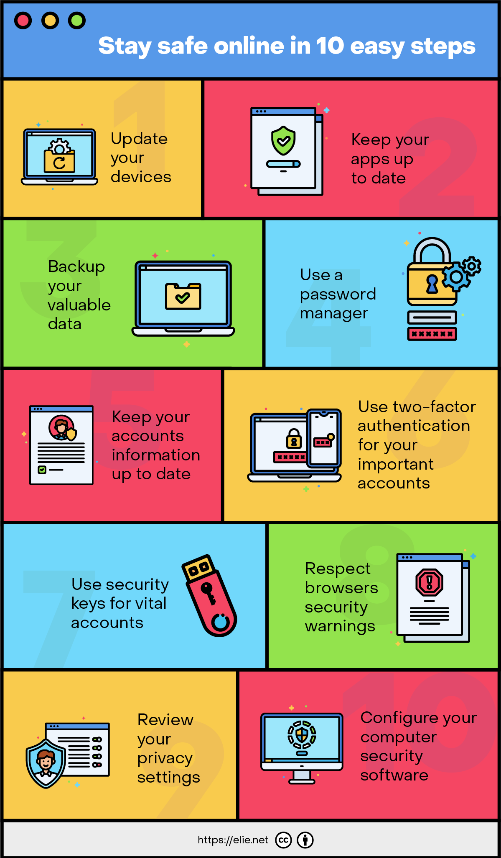
How to Stay Safe
Stronger tools like encryption, multi-factor authentication, and network monitoring should be used to stop this from happening again.
Also, we should train employees to spot fake messages and do regular system checks.
Overall, this project showed us how important it is to protect data, be careful about online threats, and use the right tools and habits to keep a business and ourselves safe.
sergey

Slide 22
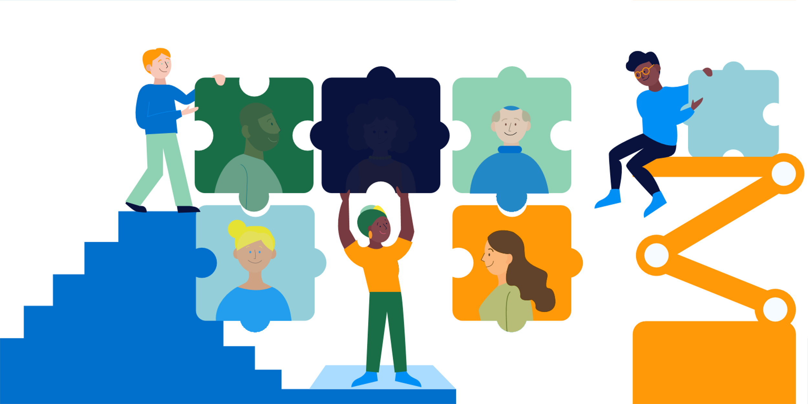
What Working together taught us
We were able to exchange ideas and view the situation from various perspectives by working on this project together.
Everybody saw different aspects of the breach and came up with different ways to help resolve it.
This gave us a deeper understanding of the case and made us consider how to defend a company against similar attacks in the future.
bohdan

Slide 23


Slide 24
How did the attackers first get into CyberProtect’s system?
A. They hacked the firewall
B. They sent a phishing email pretending to be IT Support
C. They guessed the admin password
D. They installed a virus through USB

Slide 25
Answer is
B. They sent a phishing email pretending to be IT Support

Slide 26
What does a strong password usually include?
A. Your name and birthday
B. Only lowercase letters
C. At least one number, one symbol, and a mix of upper/lowercase letters
D. The word “password”

Slide 27
Answer is
C. At least one number, one symbol, and a mix of upper/lowercase letters

Slide 28
Which of the following should you NOT do when you get an email from someone you don’t know?
A. Delete it
B. Click all the links to check what they are
C. Report it to your teacher or IT
D. Mark it as spam

Slide 29
Answer is
B. Click all the links to check what they are

Slide 30
What is encryption used for?
A. Making your screen brighter
B. Turning data into a secret code
C. Hiding viruses
D. Blocking websites

Slide 31
Answer is
B. Turning data into a secret code

Slide 32
True or False
John Doe followed company policy when he exported sensitive employee records.

Slide 33
Answer is
False

Slide 34

THANK YOU

